Slide 1
Releye – Assignment (Case)
Monika Jain
Dynamics 365 Developer

Slide 2
Prerequisites
Visual Studio 2017
Dynamics 365 Online Instance
Dynamics 365 SDK (Includes Plugin Registration tool)
Dynamics 365 online instance
URL: https://releyes.crm4.dynamics.com/
Username: monikajain@releyes.onmicrosoft.com
Password: Admin@1!

Slide 3
Implementation Steps:-
Set up a Dynamics 365 online instance and create a solution named “Account”
Create a publisher named “Releye” with prefix “rel”
Add existing Account entity into solution and configure it
Add new integer field as read-only and include the same in forms and views
Write a Plugin that calculates the total existing accounts and increased by 1 and assign that value in the newly created integer field. Signin the assembly
Write a Jquery as web resource which validates the account name and replace with the given criteria. It fires on “onchange” of account name and “onsave” of account record
Register the plugin in plugin registration tool with the following details as shown in screenshots

Slide 4
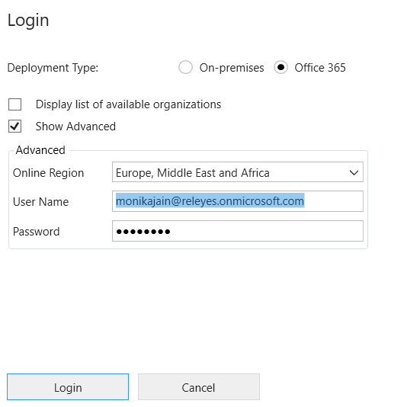
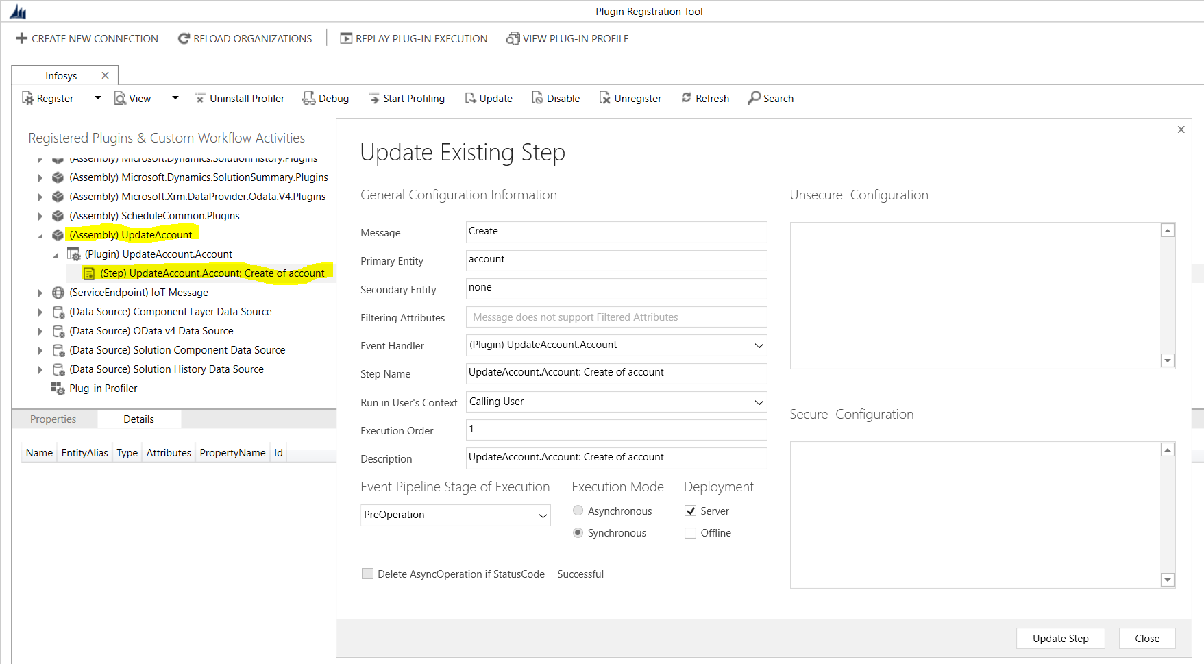
Screenshots

Slide 5
Remaining functionality:
Added the logic for 4th point, Introduce a new configuration entity named “Counter” which have 2 fields
Increment 2. Sequence number – default 0
Sequence number has value of the total count of existing accounts and Increment has configured value as 1
Put the logic in existing plugin

Slide 6
Thank You! ☺

